Slide 1
The Spanish Alphabet
“El abecedario”

Slide 2
Objectives:
I can recognize Spanish alphabets.
I can spell out my name in Spanish.
I can spell words in Spanish by listening to individual letters being said to me.
I can tell vocab with each alphabet.

Slide 3
Aa
[ah]

Slide 4
Bb
[beh]

Slide 5
Cc
[seh]

Slide 6
Ch
[cheh]

Slide 7
Dd
[deh]

Slide 8
Ee
[eh]

Slide 9
Ff
[effeh]

Slide 10
Gg
[heh]

Slide 11
Hh
[ah-cheh]

Slide 12
Ii
[eee]

Slide 13
Jj
[hota]

Slide 14
Kk
[kah]

Slide 15
Ll
[eh-leh]

Slide 16
ll
[eh-leh]

Slide 17
Mm
[emm-eh]

Slide 18
Nn
[enn-eh]

Slide 19
ñ
[eh-nyeh]

Slide 20
Oo
[oh]

Slide 21
Pp
[peh]

Slide 22
Qq
[kuu]

Slide 23
Rr
[ereh]

Slide 24
rr
[errrrrreh]
(roll tongue)

Slide 25
Ss
[eseh]

Slide 26
Tt
[teh]

Slide 27
Uu
[oo]

Slide 28
Vv
[veh]

Slide 29
Ww
[dobleh beh]

Slide 30
Xx
[eh-kees]

Slide 31
Yy
[ee-gree-eh-gah]

Slide 32
Zz
[zeh-tah]

Slide 33
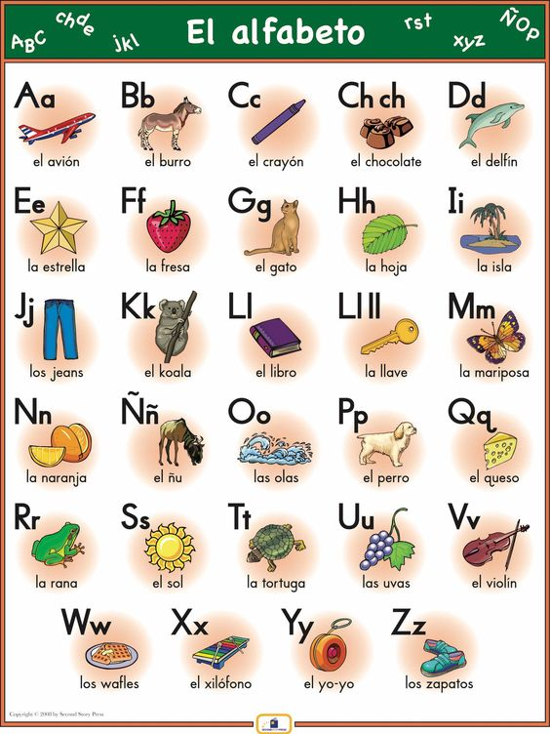

Slide 34
For Practice
https://letsspeakspanish.com/blog/spanish-alphabet/

